Slide 1
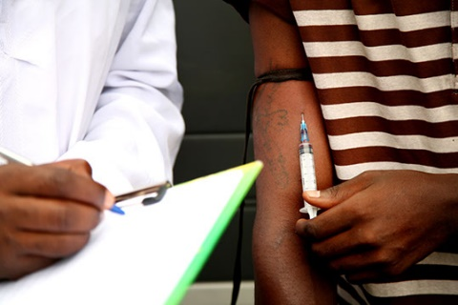
Community based Harm Reduction to fight high HIV prevalence among drug users in the north of Myanmar
SITUATION OF THESE CRIMINALIZED POPULATIONS IN KACHIN:
PEER EDUCATORS ARRESTS
“Point info” 01/03/2018

Slide 2
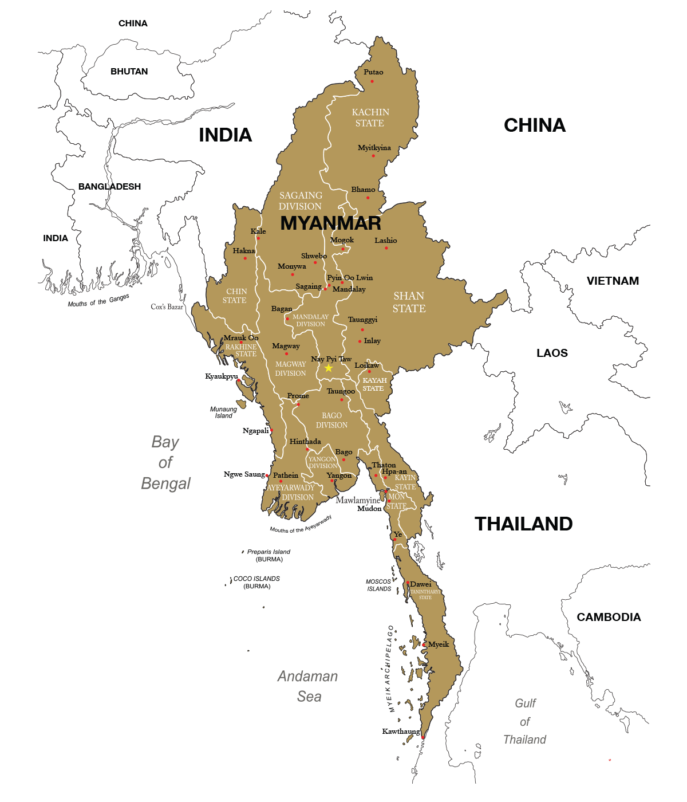
Context
Myanmar is the world’s second largest producer of illicit opium after Afghanistan.
A large share of the production is refined into heroin for the domestic and international markets.
Myanmar is one of the largest producers of methamphetamine
Kachin is a conflict affected area, mountainous and remote
Source: UNODC, Southeast Asia Opium Survey 2015
Photo credit: TNI

Slide 3
DRUG Use & HIV in Kachin
HIV and HCV prevalence among PWID in Kachin
Highest concentration of PWID in the country – 21,328 out of 83,338
High prevalence of HIV & HCV among PWID- much higher than national prevalence 25.5%
Needle sharing (73%) and sexual transmission (19%) play leading role
The HIV epidemic is driven mainly by Injecting Drug Use and acquisition of HIV among partners of PWID
HCV positivity rate among PWID -2017, MdM
Source: 2016 HIV estimates and projections- & top line findings of IBBS 2017
Notes:
Question has been raised regarding data of HCV in Myitkhyina and currently this data is updating

Slide 4
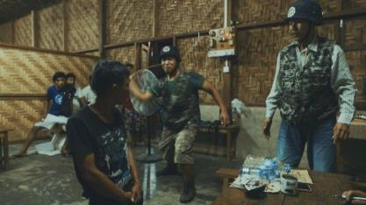
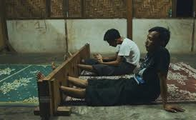
Community Resistance
Stigma & Discrimination
Frequent drives in hotspots by anti-drug organisations
Physical violence in the name of drug treatment
Involuntary detention
and forced
detoxification by
anti drug organisations
High stigma and
discrimination
Community resistance against HR especially NSP
“If they are to difficult to handle and do not listen to what we said, we beat them. If the two are fighting together, we beat both of them and put them in the pillory” (Man, Myitkyina)-
Perceptions about drug use and harm reduction in Kachin, Myanmar - A socio-anthropological, participatory approach - 2017

Slide 5
Criminalization of PWID
Field Experience
Frequent police raids in hotspots
Extortions of money
Physical violence
Punishment- cleaning of police stations & locality
Signing of bail bond ”not to use drug again”
“I went to a shooting galley early morning (around 7am) to provide services to my peers as usual. The police arrived suddenly arrested all the drug users including me. But the drug dealers run away. So the police were angry and started beating us. I explained them I am Peer Worker from MdM and show my card. They looked at the card and told me “we are too busy because of MdM, you distributed the needle and syringe” and then beaten again. They took me to the police station and also called village leader. They force me to sign bail bond and released”
Peer Worker, July 2018

Slide 6
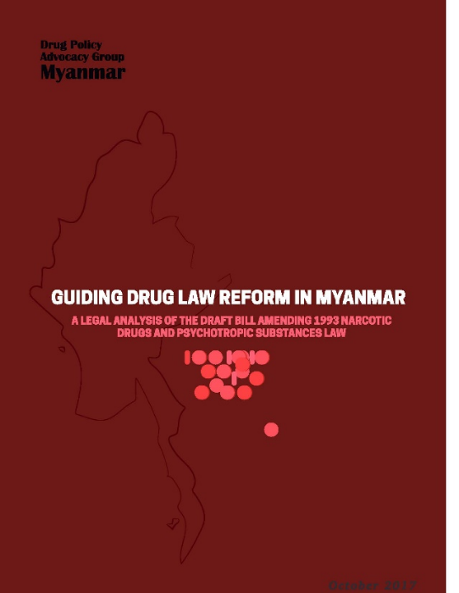
NORMATIVE CONTEXT
Myanmar National Strategic Plan on Viral Hepatitis (2016-2020) + National Drug Control policy: Harm reduction recognized as key strategy in both !!!
BUT Amendment to the 1993 Narcotic Drugs and Psychotropic Substances Law…. Better greater emphasis on public health BUT… drug users who are caught with small quantities of drugs for their own consumption will continue to risk 5 to 10 years of incarceration.

Slide 7
THE CRACKDOWN CONTEXT
Mapping Exercise
New Law
Amendment to 1993 Narcotic Law
Speech form Myanmar President
Speech form State General prosecutor
Feb 14
National Drug Control policy
June 27
Aug 17
Feb 20
Nov
2018
Feb
Mar
Apr
May
June
July
Aug
Sept
Oct
Dec
Arrest n°1
Hotspot Visit
Aug 14
Oct 6
Arrest n°2
Sept 2
Arrest n°3
Sept 27
Arrest n°4
Dec 3
3 months mapping exercise to list:
Contact details of all know drug dealers, drug users and hotspots
With the support of the local administration and « Pat Jasan »

Slide 8
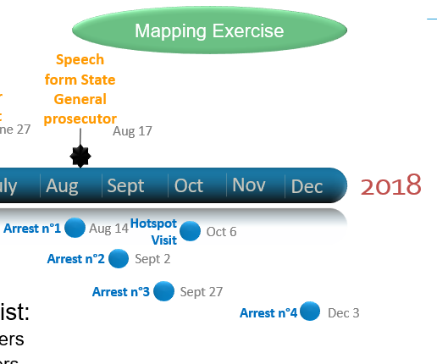
THE CRACKDOWN CONTEXT FOR MdM
1st arrest at home : One or two bottles of Heroin and Charged for Drug Possession
Internal investigation demonstrated that he was arrested for drug dealing but made a deal with the police. Hence, he was only charged with drug possession and not drug dealing. Sentenced to 7 years of imprisonment
2nd arrest during Prevention Activities : found in possession of 0,01g of heroin powder and she was then arrested and charged for drug possession
400 N&S and 100 condoms ceased by the Police
Trial still ongoing

Slide 9
THE CRACKDOWN CONTEXT FOR MDM
3rd Arrest at home: 0.1g of heroin and 4 tablets of ATS in her house. Charged our female Peer Worker for drug possession.
Sentenced to 5 years of imprisonment
Hot spot visit: 20 persons (Police, local administration) visiting 1 hotspot with 1 Peer delivering Prevention messages to 30 IDUs – No drugs found = only social punishment to clean the village
4th Arrest at home: 0.3g heroin. Charged our male Peer Worker for drug possession
Trial still ongoing

Slide 10
Thanks for your attention

